Slide 1


COMPUTER
TYPES OF COMPUTER

Slide 2
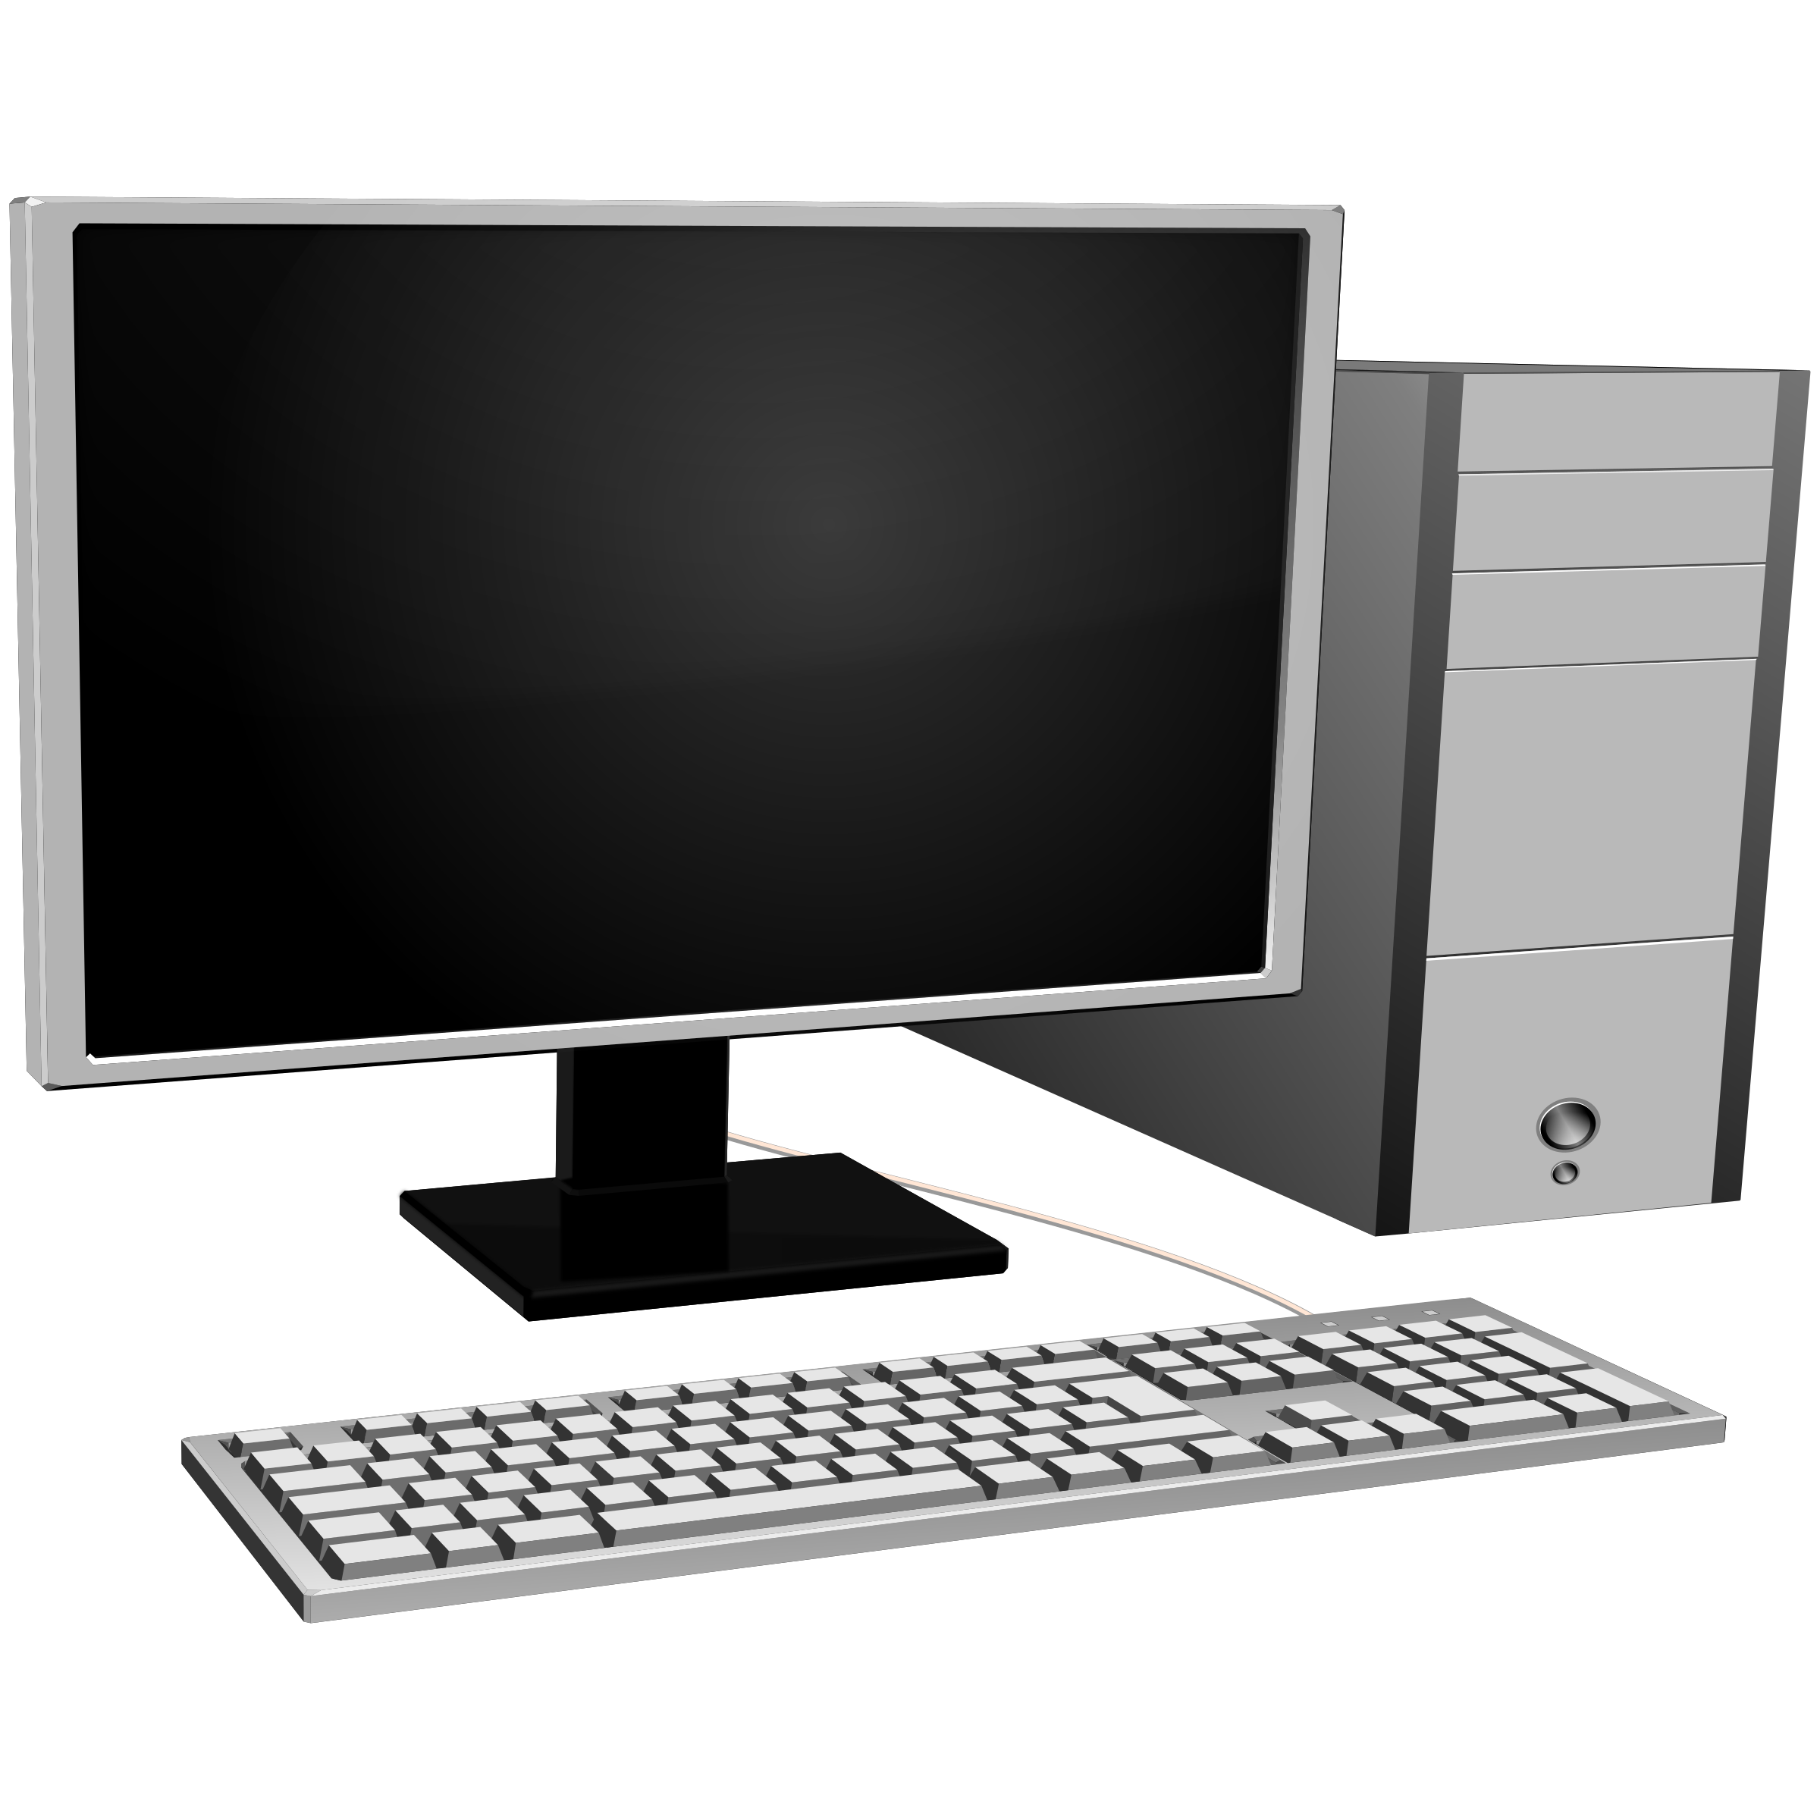
1.COMPUTER
A computer is a machine that can be programmed to automatically carry out sequences of arithmetic or logical operations. Modern digital electronic computers can perform generic sets of operations known as programs. These programs enable computers to perform a wide range of tasks.

Slide 3
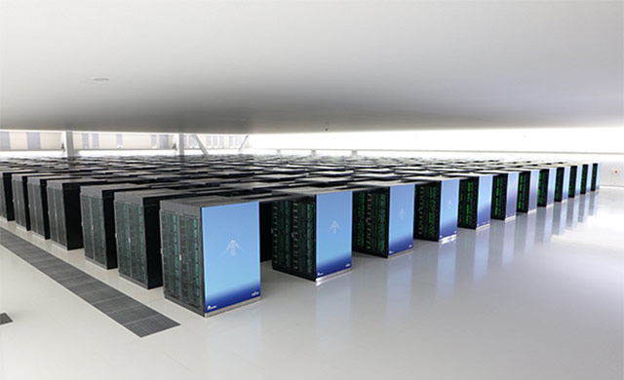
2.SUPER COMPUTER
A computer is a machine that can be programmed to automatically carry out sequences of arithmetic or logical operations. Modern digital electronic computers can perform generic sets of operations known as programs. These programs enable computers to perform a wide range of tasks.

Slide 4
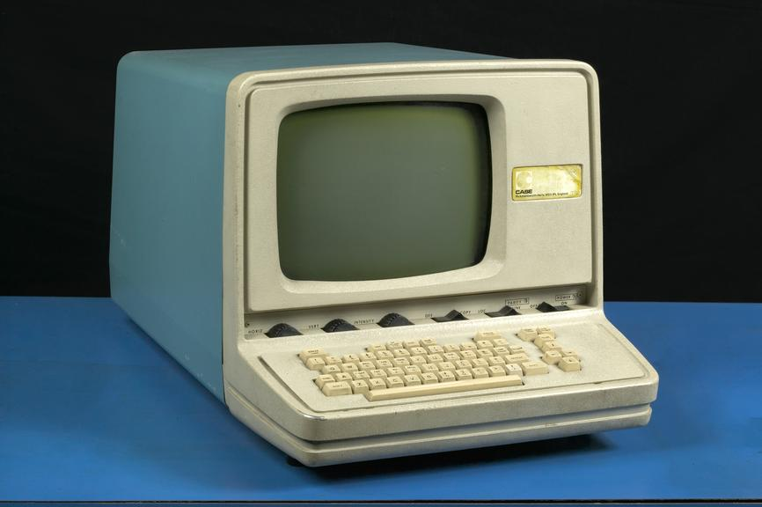
3.MAINFRAME COMPUTER
A computer is a machine that can be programmed to automatically carry out sequences of arithmetic or logical operations. Modern digital electronic computers can perform generic sets of operations known as programs. These programs enable computers to perform a wide range of tasks.

Slide 5
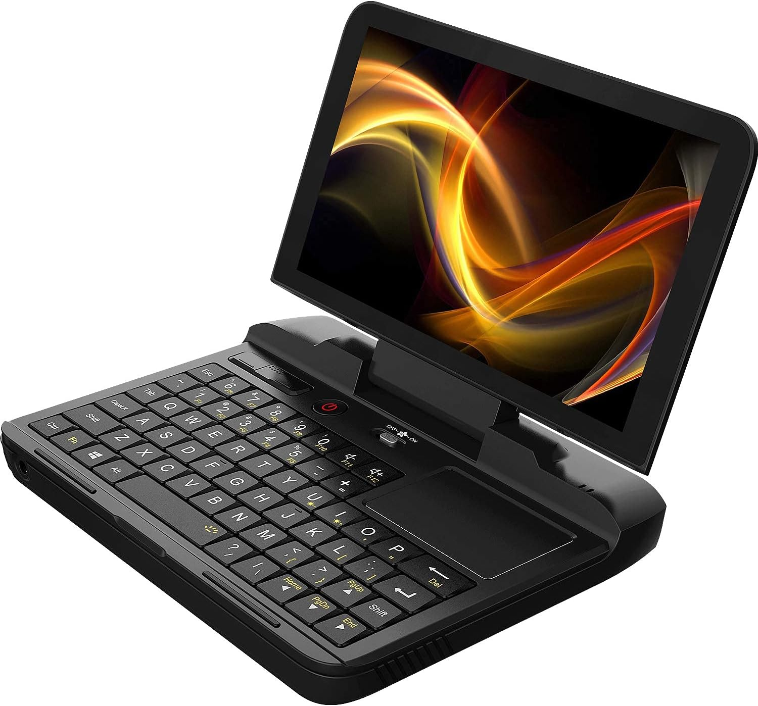
4. Mini computer
A minicomputer, or colloquially mini, is a type of smaller general-purpose computer developed in the mid-1960s and sold at a much lower price than mainframe and mid-size computers from IBM and its direct competitors.

Slide 6
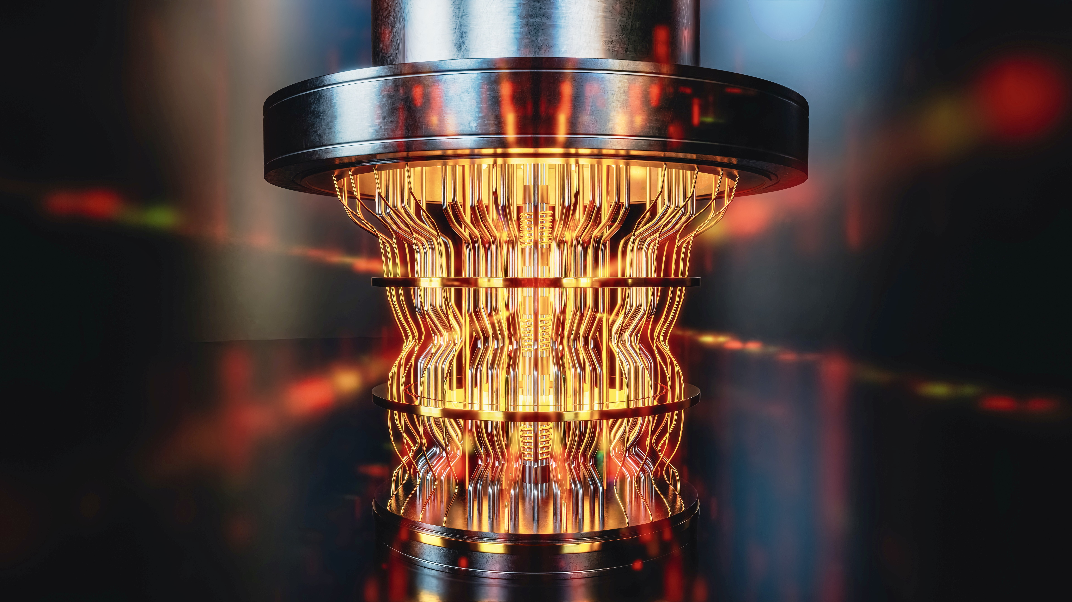
5.QUANTUM COMPUTER
A quantum computer is a computer that takes advantage of quantum mechanical phenomena. On small scales, physical matter exhibits properties of both particles and waves, and quantum computing leverages .

Slide 7
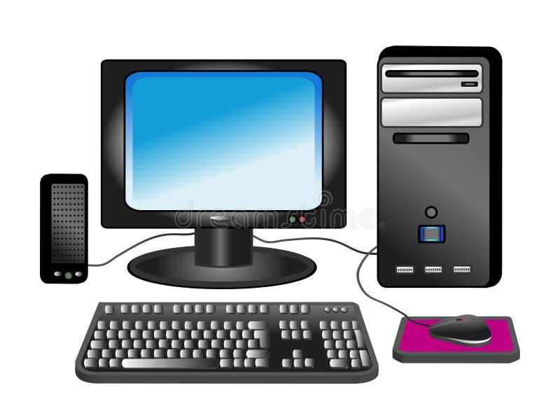
6. PERSONAL COMPUTER {pc}
A personal computer, often referred to as a PC, is a computer designed for individual use. It is typically used for tasks such as word processing, internet browsing, email, multimedia playback, and gaming.

